Slide 1

Swiss Data Science Center
Julien Eberle - 30.04.2018

Slide 2
Agenda
Swiss Data Science Center
Our vision of data science
Challenges in data science
The RENGA platform
Best practices

Slide 3
IT Terminology
Infrastructure: Collection of hardware components and operating system (OS) to offer a compute & storage environment
Cloud computing: Infrastructure offered as a service (IaaS)
(Software) platform: Software components sitting between the Operating System (OS) and the user-facing applications (middleware)
Open platform: Software system based on open standards, such as published and fully documented external application programming interfaces (API) for optimal interoperability
Data lineage: It includes the data's origins and where it moves over time (provenance of the data) for optimal traceability and reproducibility
Knowledge graph: Representation of meta-data and knowledge as entities and their relations, following a given nomenclature.
Federated: Unite infrastructures and databases from mutually untrusted distributed parties (e.g. Genome Center, USZ) without compromising the individual security & privacy policies of the involved parties

Slide 4
1. Swiss Data Science Center (SDSC) A joint national center between EPFL and ETH Zürich
Mission: foster adoption of data science in academia and industrial sector
Demonstrate value of data science through strategic partnerships with early adopters
Team: large multi-disciplinary team of data and computer scientists (40)
Excellence in academic research backed by strong industrial experience
Focus on real-life applications bringing tangible results
?
<<<<<<
Embedded R&D
collaboration
Domain-specific
Insights as a Service
Open (Data) Science
We engage in academic and industrial collaborations requiring large-scale distributed data processing (Big & Fast Data) and/or advanced analytics (machine learning) combined with an in-depth knowledge in select domains
We provide secure access to our cloud-hosted analytics platform – named RENGA, a highly scalable open software platform offering a one-stop-shop for hosting and exploring curated, calibrated and possibly anonymized data at scale, at-rest or in-motion
The RENGA platform offers
user-friendly tooling and services to help with the adoption of Open Science, fostering research productivity and excellence.
www.datascience.ch

Slide 5
Where does SDSC fit?
Domain expertise
Environmental
Sciences
Personalized
Health
Manufacturing intelligence
Digital Humanities
Swiss Data Science Center
Applied
Research
Basic Research in
Data science
Data management
Data security
& privacy
Statistics
Machine learning
Operations
research
Visualization
Notes:
Each academic discipline could be associated to labs on the ETH Domain
Now, along the other dimension… from basic research in data science to… domain science where domain expertise lies
There is a gap. If you want to solve a real problem in one of the domains, things can get tricky. Especially because many real-world problems in data science are multidisciplinary by nature, and that labs focus deep on a specific academic discipline.

Slide 6

2. A Fragmented Ecosystem
Data mining
DOMAIN
EXPERTS
Algorithms
Statistics
Personalized health
Smart cities
Environmental sciences
Material sciences
Social sciences
Economics
Digital humanities
DATA
SCIENCE
Data
management
GAP
Machine learning
Visual analytics
Operations research
How can I best match the right drug with the right dosage to the right patient at the right time?
Visualization
What is the hyperplane that best separates two classes of points in multidimensional space?
Notes:
-

Slide 7

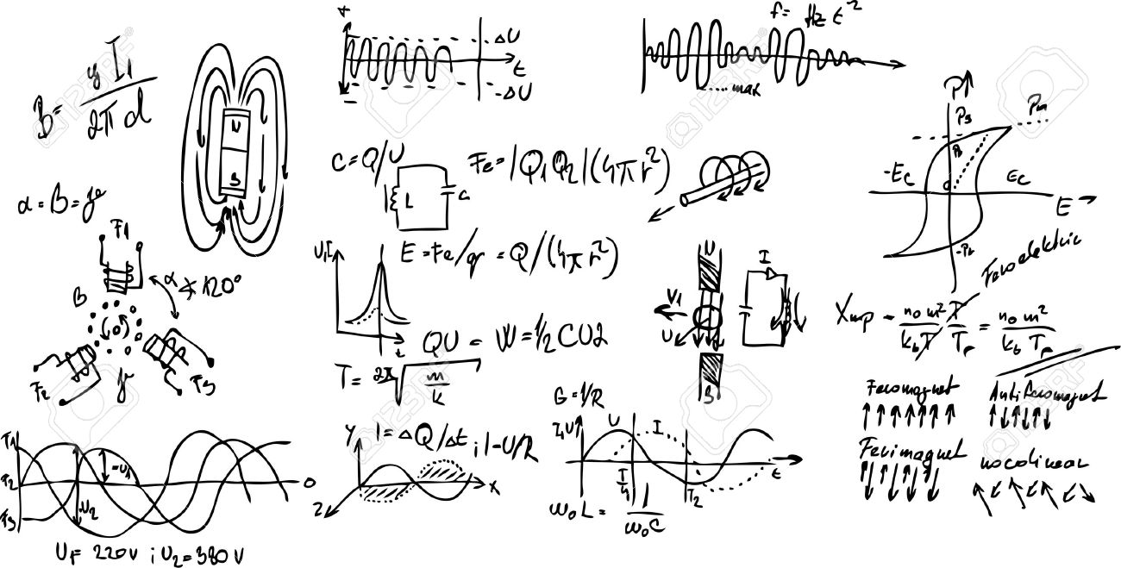
The actors of data science
Foster adoption of data science both in academia and industry
Multi-disciplinary team of 40 full-time computer and data
scientists, and domain experts
How can I best match the right drug with the right dosage to the right patient at the right time?
+
Domain experts
What is the hyperplane that best separates two classes of points in multidimensional space?
How is my data protected?
How private is it?
How exactly is it used?
Data scientists
Data providers
Notes:
- federate data providers, data and computer scientists, and subject-matter experts
foster scientific breakthroughs with significant societal impact.

Slide 8
Data Science Maturity Model
0
Pen & Paper analytics, Ad-hoc processes
1
Automated acquisition
Data Storage, tools
2
Annotated, meta-data
Data sharing, data management
3
Reusable, combinable
Reproducible, defined workflows
4
5
Meta-research
No documentation
Documented processes
Process sharing, collaborative tools
Global knowledge representation, federated
Inspired by CMMI and https://blog.dominodatalab.com/introducing-the-data-science-maturity-model/

Slide 9
3. Data Science challenges
Interoperability / Standards for sharing
Reproducibility / Reusability
Privacy preservation

Slide 10
FAIR Principles
Findable
data and meta-data should be easy to find by both humans and computers
Accessible
data and meta-data should be stored for the long-term, such that they can be easily accessed and downloaded using standard communication protocols, with respect to access permissions.
Interoperable
data is ready to be exchanged, interpreted and combined in a (semi)automated way with other data sets
Reusable
Data and metadata are well-described and can be reused in future research. Proper citation must be facilitated, and the conditions under which the data can be used should be clear to machines and humans
Explanation of FAIR principles:
http://www.snf.ch/SiteCollectionDocuments/FAIR_principles_translation_SNSF_logo.pdf
Drivers and barriers of open science: https://ec.europa.eu/research/openscience/index.cfm?pg=drivers&section=monitor
Notes:
Explanation of FAIR principles http://www.snf.ch/SiteCollectionDocuments/FAIR_principles_translation_SNSF_logo.pdf
Drivers abd barriers of open science: https://ec.europa.eu/research/openscience/index.cfm?pg=drivers&section=monitor
Socio-technical impediments of open-data: http://www.ejeg.com/issue/download.html?idArticle=255 (2012)

Slide 11
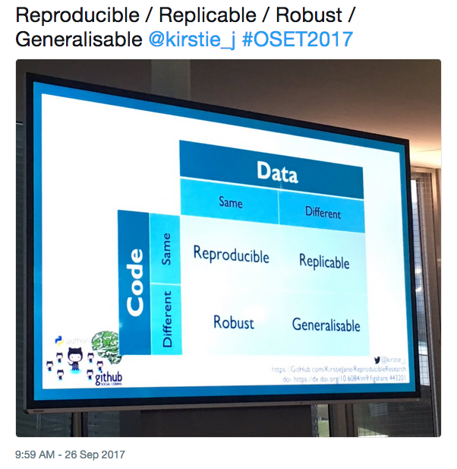
Reproducible, Replicable, Robust
https://twitter.com/lore_salvatori/status/912723417832595456
Research is <?> if we come to the same
result or conclusion when
code is <?> and data is <?>
Notes:
Recent twitt about Reproducible vs Replicable, vs Robust, vs Generalizable, Research (sometime they also throw in “Repeatable”)
Still a lot of confusion in the scientific community and industry, with varying domain-specific interpretations
In red – our interpretation

Slide 12
Privacy Assessment
Privacy-sensitive data:
Health-related data: MRI, medical treatment, genome, lifestyle-tracking data, …
Location data:
Your traces can reveal a lot about you (religious or political views, affairs, friendship [1], …)
Four spatio-temporal points are enough to uniquely identify 95% of individuals [2]
Social network data: a wealth of information (see Facebook/Cambridge Analytica scandal)
Privacy risks:
De-anonymization [3,4], re-identification [5]
Membership inference (against machine learning or databases) [6]
Attribute inference [7]
Mutual/interdependent risks: when your data-sharing behavior affects others’ privacy
Occurring with genomic data [7], location data [8], and social network data [9]
[1] Backes et al., walk2friends: Inferring Social Links from Mobility Profiles, CCS, 2017
[2] De Montjoye et al., Unique in the crowd: The Privacy bounds of human mobility, Nature, 2013
[3] Narayanan and Shmatikov, Robust de-anonymization of large sparse datasets, S&P, 2008
[4] Humbert et al., De-anonymizing genomic databases using phenotypic traits, PoPETs, 2015
[5] Gymrek et al., Identifying personal genomes by surname inference, Science, 2013
[6] Shokri et al., Membership inference attacks against machine learning models, S&P, 2017
[7] Humbert et al., Addressing the concerns of the Lacks family: quantification of kin genomic privacy, CCS, 2013
[8] Olteanu et al., Quantifying interdependent privacy risks with location data, IEEE TMC, 2017
[9] Biczok et al., Interdependent privacy: let me share your data, FC, 2013

Slide 13
Privacy Protection
Access control
Attribute-based access control (ABAC)
Role-based access control (RBAC)
Identity-based access control (IBAC)
Cryptographic mechanisms
Homomorphic encryption: allows you to perform computations directly on the encrypted data without decrypting them (except the final result)
Computation in the encrypted domain -> affecting the efficiency of the system
Differential privacy
Perturbing the released statistics to avoid membership inference
Adding noise to the statistics -> affecting the utility of the result

Slide 14
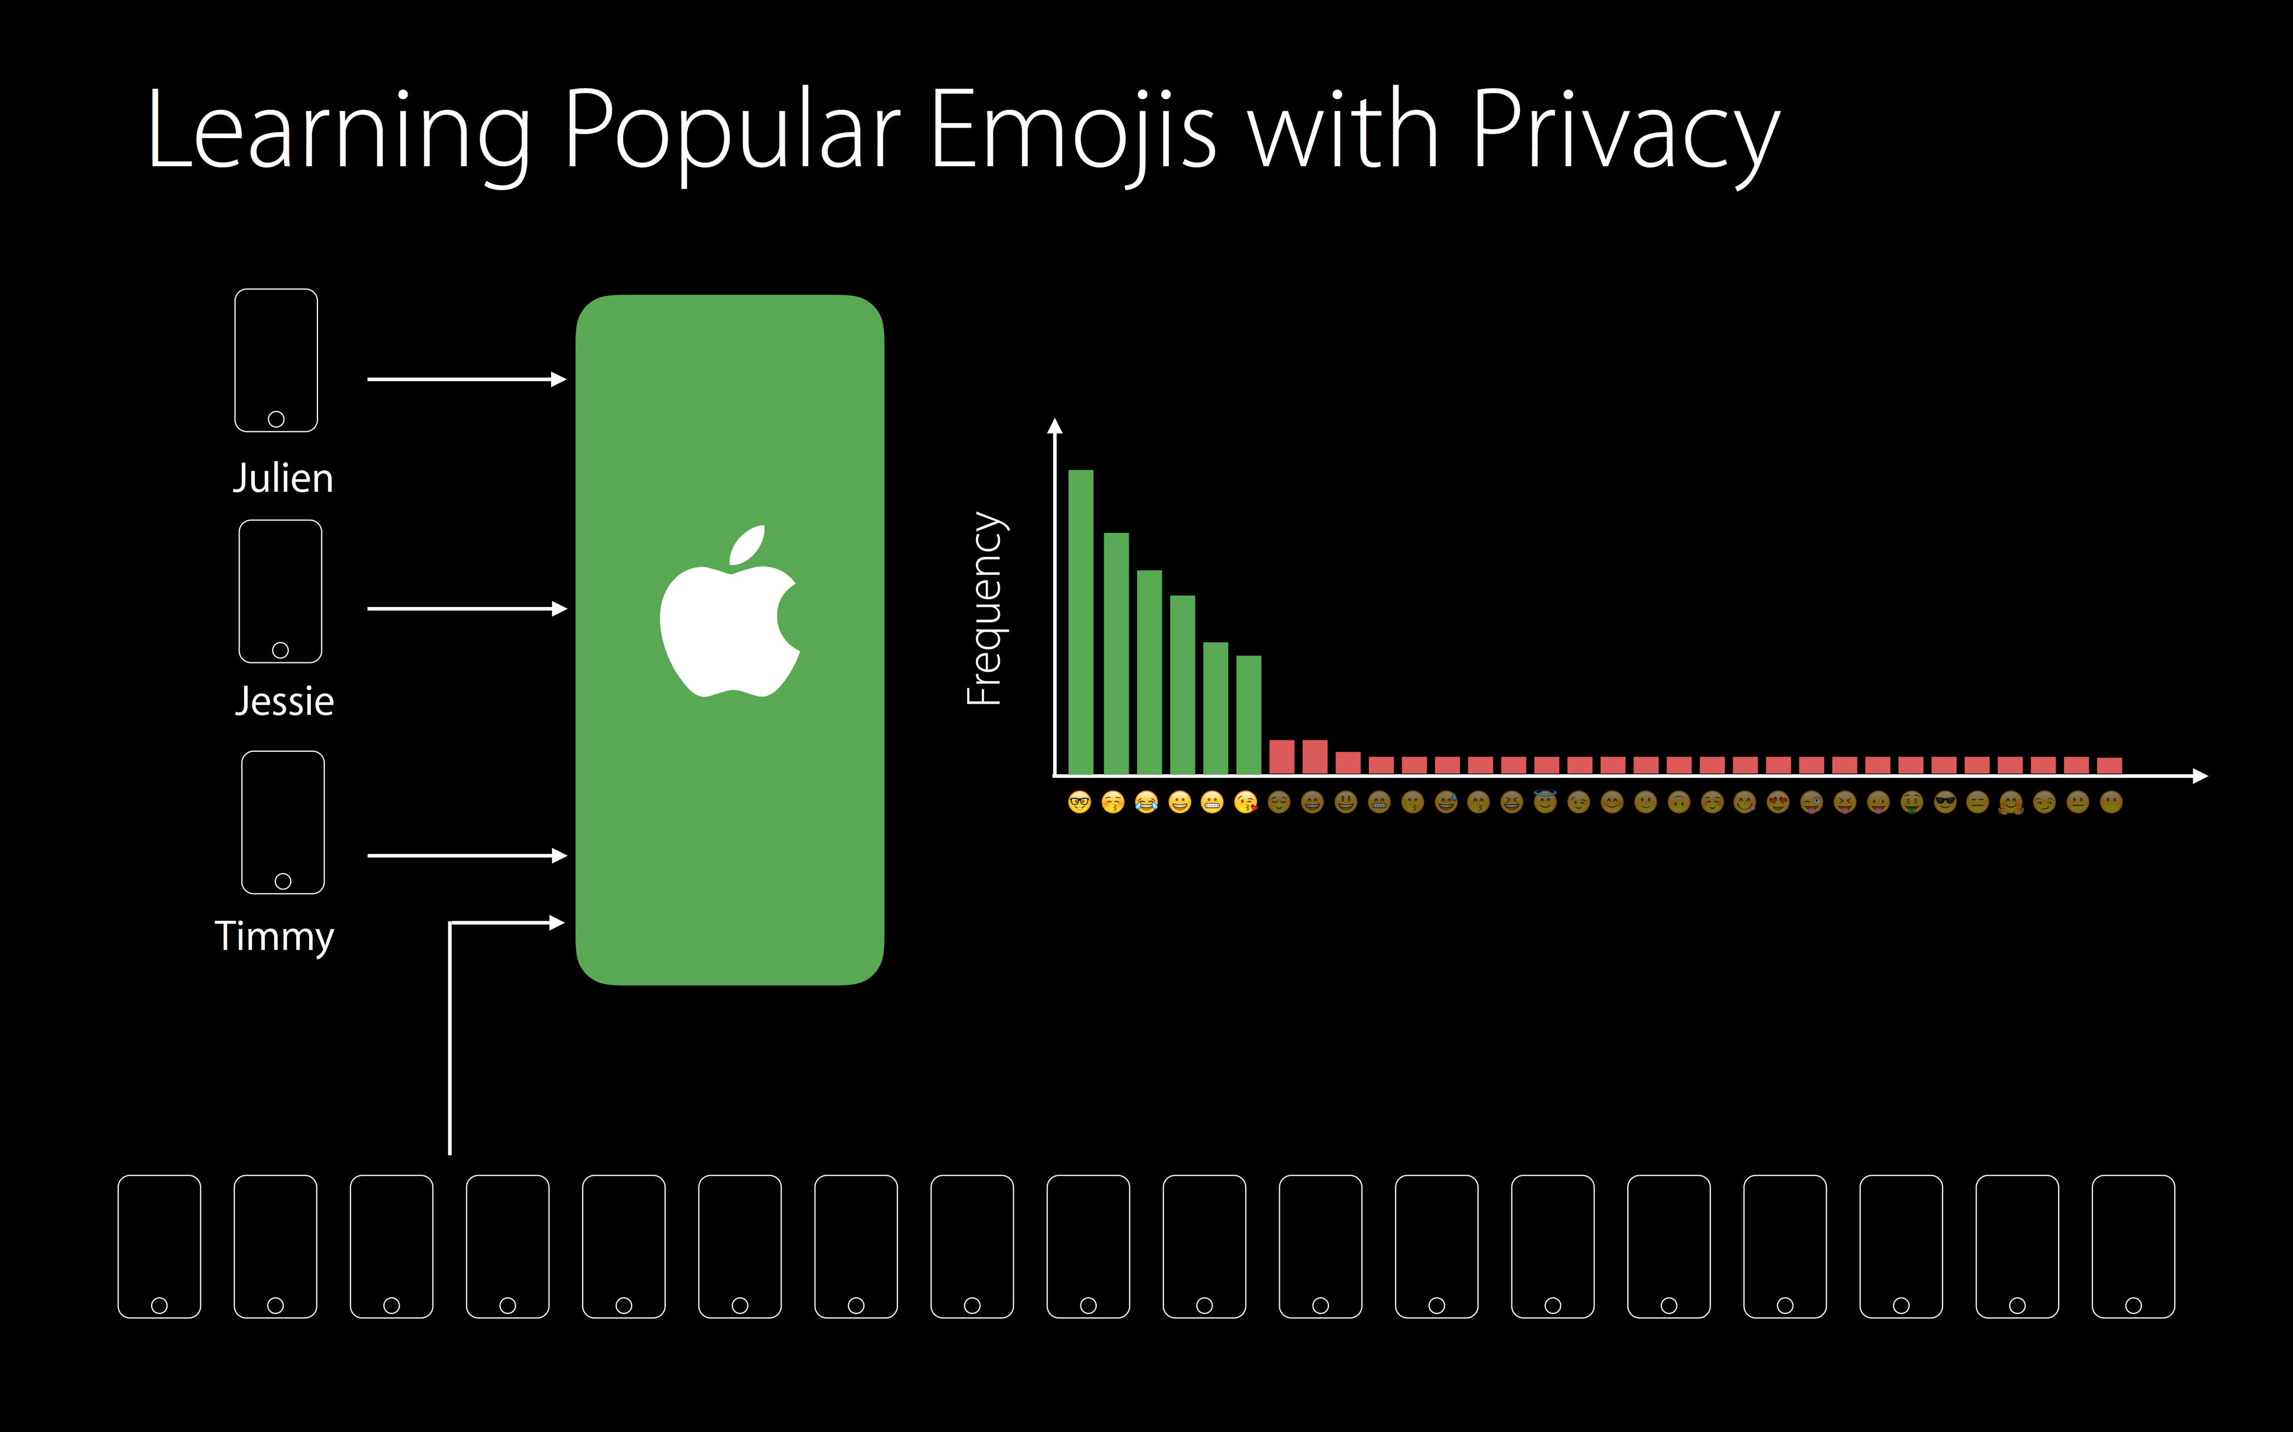
Differential privacy
Apple WWDC 2016 slide

Slide 15
4. RENGA
Renga (連歌), plural renga, a genre of Japanese linked-verse poetry in which two or more poets supply alternating sections of a poem linked by verbal and thematic associations.
—Encyclopædia Britannica
Renga is a highly-scalable & secure open software platform designed to foster multidisciplinary data (science) collaboration across mutually untrusted academic and industrial institutions.
The platform allow practitioners to:
Securely manage, share and process large-scale data across untrusted parties operating in a federated environment.
Capture complete lineage automatically up to original raw data for detailed traceability (auditability & reproducibility)
Adhere to FAIR principles and enable reproducible research

Slide 16

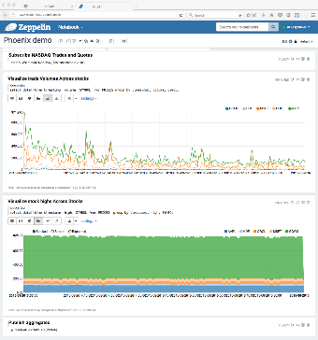

Open (Data) Science
Reproducible Research
See the (versioned) algorithms
See the data
Replay a workflow
Compare workflows, validate robustness
Reusability
Reuse data on new workflows
Clone and modify workflows
Knowledge Graph
Data popularity, H-index
Who is using the data?
For what?
Data science of data science, recommender systems, …
IP Protection
Decide who sees the data,
The algorithms,
The data I use,
And how I use it
Data0
Data1
App A
App B
App C
Data2
Data3
Data4
App D
Company A
Data5
Data7
employee
dev
research
Dr John Doe
Notebook
Publication Y
cite
Data6
Data8
Reference
author
cite
time | T Cº | RH%
00:30 | 14 | 30
00:30 | 13 | 32
01:00 | 13 | 34
01:30 | 12 | 35
02:00 | 12 | 35
02:30 | 12 | 36
03:00 | 11 | 40
03:30 | 11 | 42
04:00 | 11 | 40
Dr Janne Roe
employee
Publication Z
author
research
Company B
Dr Moe Szyslak
Research topic
research

Slide 17
3 Pillars of RENGA
a highly-scalable & secure open software platform designed to foster multidisciplinary data (science) collaboration across mutually untrusted academic and industrial institutions
Cross-organization collaboration framework
Pool content, analytics & infrastructure from multiple autonomous organizations,
Respect every organization’s sovereignty.
Secure, Scalable, Reliable, Decentralized.
Non-intrusive, integrate with Data Scientist’s favorite IDEs for faster adoption
Facilitate repeatable research
Automatic journaling of data science processes.
Aid in research retrieval and reuse.
Open platform
Extensible with new types of services and tools without compromising security
Data science on data science,
Agile data science frameworks for rapid R&D,

Slide 18
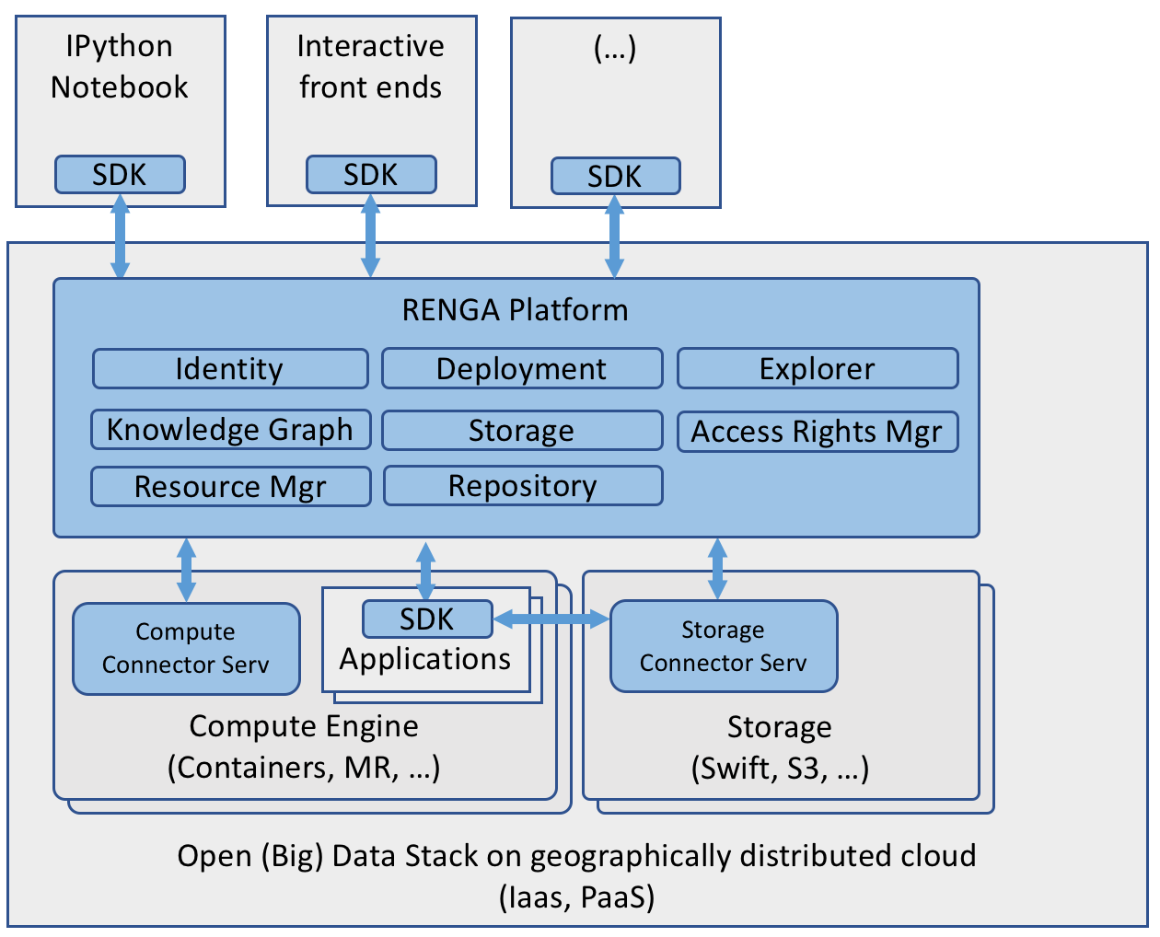
RENGA Software Stack

Slide 19










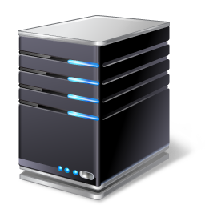
The Software Stack
Domain specific notebook and analytics
Environmental Science
Transport
Personalized Health
Social science
Users, data scientists
SDK
SDK
SDK
SDK
SDK
Common API
Micro services
- Security
- Privacy
- Federation
- Reproducible research
- Data protection
Data Processing Execution Environment
SDSC and partners
Open Big Data Platform Stack
Geographically distributed cloud and on premise infrastructure(s) +
long term storage solution providers for archiving
IaaS
S3
Notes:
Note that we do not and will not own hardware! So we will not own compute and storage servers. Instead we will work hand-in-hand with the infrastructure providers, including of course the national providers SWITCH and CSCS

Slide 20



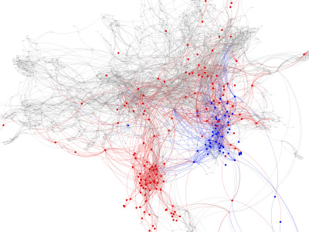
Automated Knowledge Graph
subscribe(Data4)
Find
Access
Interoperate
Reuse
App A
App B
App C
Distributed Graph in Federated Environment
Data1
Data2
Data3
App D
publish(Data5)
Data4
Notebook
Data5
Insights Factory
Data5
Application Repository
Data

Slide 21
5. Best practices
Keep your data FAIR
Standard and open formats (csv, hdf5, …)
Enhance it with meta-data (human and machine readable)
Share your code with the data
Make sure it is reproducible
Include/define all needed dependencies
Ensure a proper lineage
Use unambiguous references for input data
Publish output data (if possible)
Describe the workflow (which process on which input)
https://portal.hdfgroup.org/display/support

Slide 22
Some tools
Jupyter notebooks / lab: https://jupyter.org/
Interactive notebooks
Git / Github / Gitlab
Version control for code (and data?)
Docker: https://docker.com
Container for 1:1 reproducibility
Binder: https://mybinder.org/
Automated packaging of notebooks on Github
Zenodo: https://www.zenodo.org/
Get a DOI and publish your data/code/…

Slide 23
Questions ?
https://datascience.ch Twitter: @SDSCdatascience

